Slide 1
Z3: A Decision Engine for Software
Nikolaj Bjørner and Leonardo de Moura
Microsoft Research
TCN Programming Languages event, January 31st
Slides: http://my/sites/redmond_nbjorner/

Slide 2

RiSE – a primer
Symbolic Reasoning
Engines using Z3
What is SMT?
Little Engines of Proof
Solver: Interaction
Directions
Extra: Nuts and Bolts
RiSE
Microsoft Research Redmond

Slide 3
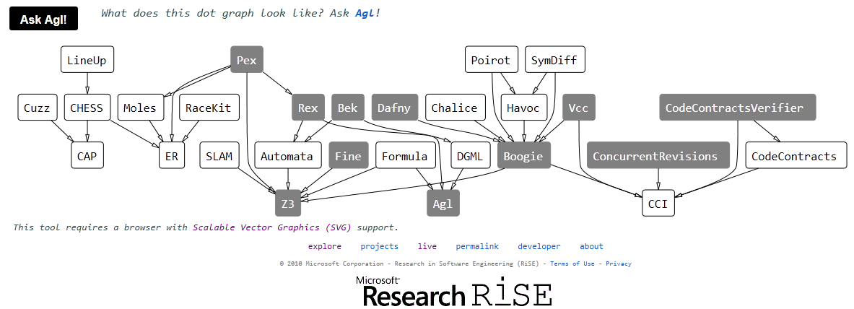
RiSE: Research in Software Engineering
http://rise4fun.com/AGL/rise

Slide 4
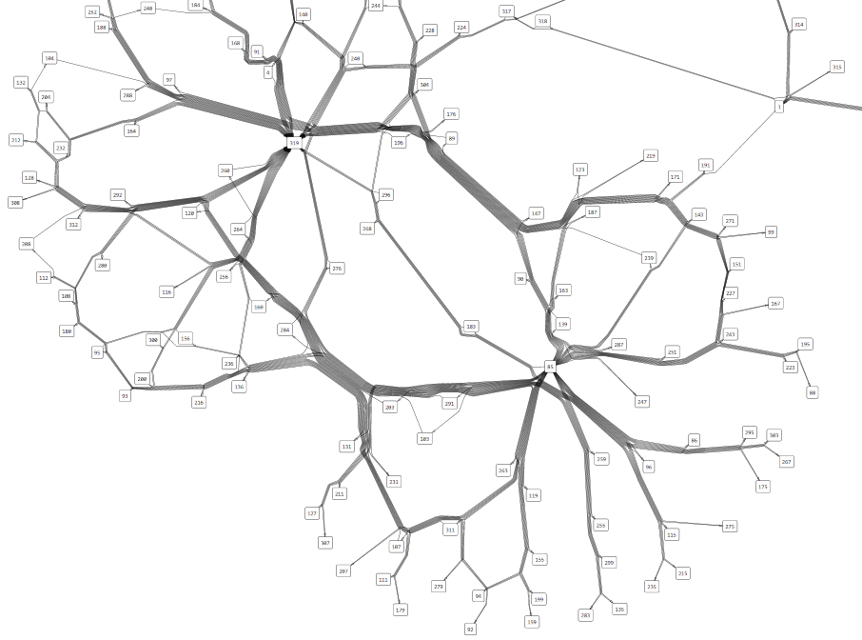
AGL – Automatic Graph Layout
Lev Nachmanson
Tim Dwyer
Ted Hart
Alexander Holroyd
Applications:
Dev10 Progression
Dev11Tuvalu
SpecExplorer
Many others

Slide 5
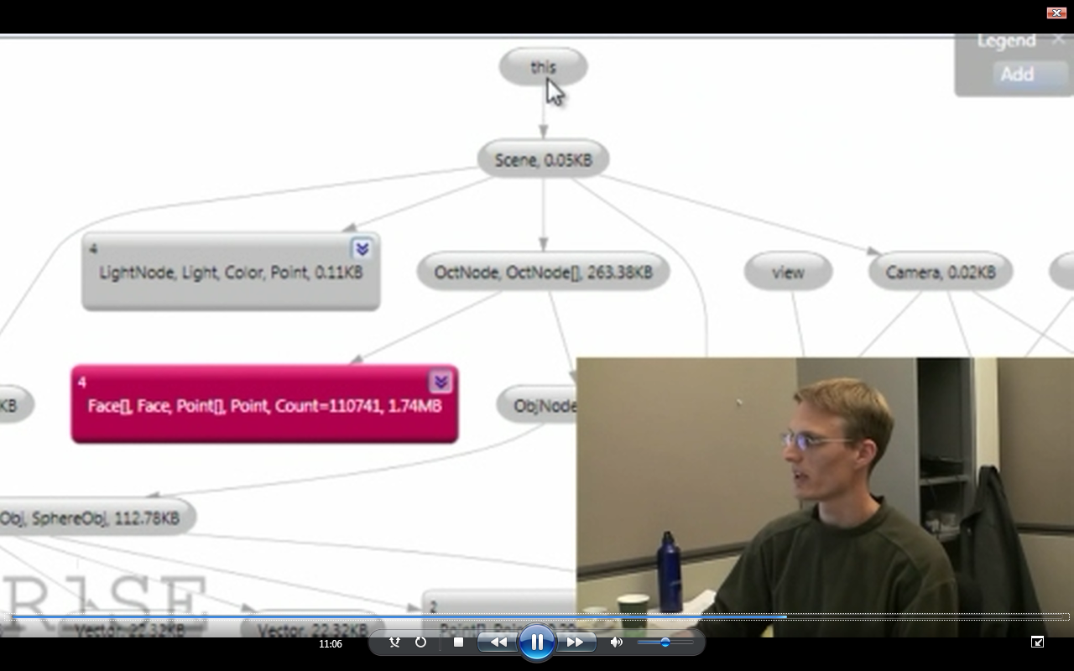
CCI and ER
CCI2:
Common Compiler Infrastructure v2
Herman Venter
ER: Extended Reflection Nikolai Tillmann
HeapDbg uses CCI+AGL
Manuel Fändrich
Mark Marron

Slide 6

Cuzz: Concurrency Fuzzing
Parent
Child
void* p = 0;
CallCuzz();
CreateThd(child);
CallCuzz();
p = malloc(…);
void* p = 0;
CreateThd(child);
p = malloc(…);
void* p = 0;
RandDelay();
CreateThd(child);
RandDelay();
p = malloc(…);
void* p = 0;
RandDelay();
CreateThd(child);
Instrument calls to Cuzz
Insert random delays
Use the Cuzz algorithm to determine when and by how much to delay
Init();
RandDelay();
DoMoreWork();
RandDelay();
p->f ++;
Init();
RandDelay();
DoMoreWork();
Init();
DoMoreWork();
p->f ++;
Init();
CallCuzz();
DoMoreWork();
CallCuzz();
p->f ++;
RandDelay();
p = malloc(…);
RandDelay();
p->f ++;
This is where all
the magic (probabilistic analysis) is
Cuzz by Madan Musuvathi, Sebastian Burckhardt - in AppVerifier, used to find bugs in SQL, IE, ACPI, Kernel

Slide 7
RiSE - a primer
Symbolic Reasoning
Engines using Z3
What is SMT?
Little Engines of Proof
Solver: Interaction
Directions
Extra: Nuts and Bolts
Symbolic
Reasoning

Slide 8
Tools using the Z3 Decision Engine
http://research.microsoft.com/projects/z3

Slide 9
Symbolic Reasoning
Verification/Analysis tools need some form of Symbolic Reasoning

Slide 10
What is logic?
Logic is the science of effective symbolic reasoning.
How can we draw general and reliable conclusions from a collection of facts?
Formal logic: Precise, syntactic characterizations of well-formed expressions and valid deductions.
Formal logic makes it possible to calculate consequences at the symbolic level.
Computers can be used to automate such symbolic calculations.

Slide 11
Symbolic Reasoning
Logic is “The Calculus of Computer Science” (Z. Manna).
Succinct: High computational complexity
Undecidable
(FOL + LA)
Semi-decidable
(First-order logic)
NEXPTime-complete
(EPR)
PSpace-complete
(QBF)
NP-complete
(Propositional logic)
P-time
(Equality)

Slide 12
Symbolic Engines: SAT, FTP and SMT
SAT: Propositional Satisfiability.
(Tie ∨ Shirt) ∧ ( ¬Tie ∨ ¬Shirt) ∧ (¬Tie ∨ Shirt)
FTP: First-order Theorem Proving.
∀X,Y,Z [X*(Y*Z) = (X*Y)*Z] ∀X [X*inv(X) = e] ∀X [X*e = e]
SMT: Satisfiability Modulo background Theories b + 2 = c ∧ A[3] ≠ A[c-b+1]

Slide 13
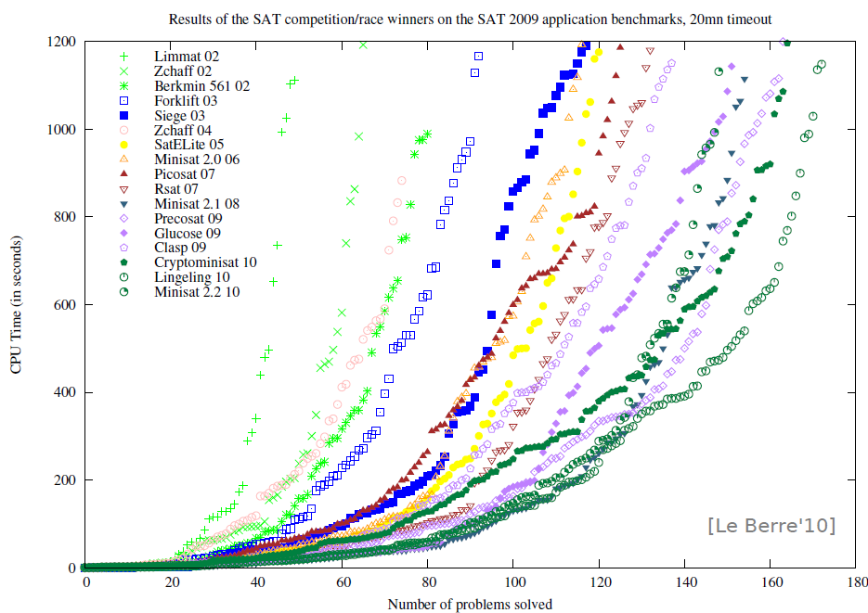
SAT - Milestones
Problems impossible 10 years ago are trivial today
year | Milestone
1960 | Davis-Putnam procedure
1962 | Davis-Logeman-Loveland
1984 | Binary Decision Diagrams
1992 | DIMACS SAT challenge
1994 | SATO: clause indexing
1997 | GRASP: conflict clause learning
1998 | Search Restarts
2001 | zChaff: 2-watch literal, VSIDS
2005 | Preprocessing techniques
2007 | Phase caching
2008 | Cache optimized indexing
2009 | In-processing, clause management
2010 | Blocked clause elimination
Concept
2002
2010
Millions of variables from
HW designs

Slide 14
FTP - Milestones
Year | Milestone | Who | Year | Milestone | Who
1930 | Hebrand's theorem | Herbrand | 1970 | Completion and saturation procedures | many people and provers
1934 | Sequent calculi | Gentzen | 1970 | Knuth-Bendix ordering | Knuth; Bendix
1934 | Inverse method | Gentzen | 1971 | Selection function | Kowalski; Kuehner
1955 | Semantic tableaux | Beth | 1972 | Built-in equational theories | Plotkin
1960 | Herbrand-based theorem proving | Wang Hao | 1972 | Prolog | Colmerauer
1960 | Ordered resolution | Davis; Putnam | 1974 | Saturation algorithms | Overbeek
1962 | DLL | Davis; Logemann; Loveland | 1975 | Completeness of paramodulation | Brand
1963 | First-order inverse method | Maslov | 1975 | AC-unification | Stickel
1965 | Unification | J. Robinson | 1976 | Resolution as a decision procedure | Joyner
1965 | First-order resolution | J. Robinson | 1979 | Basic paramodulation | Degtyarev
1965 | Subsumption | J. Robinson | 1980 | Lexicographic path orderings | Kamin; Levy
1967 | Orderings | Slagle | 1985 | Theory resolution | Stickel
1967 | Demodulation or rewriting | Wos; G. Robinson; Carson; Shalla | 1986 | Definitional clause form transformation | Plaisted; Greenbaum
1968 | Model elimination | Loveland | 1988 | Superposition | Zhang
1969 | Paramodulation | G. Robinson; Wos | 1988 | Model construction | Zhang
 |  |  | 1989 | Term indexing | Stickel; Overbeek
 |  |  | 1990 | General theory of redundancy | Bachmair; Ganzinger
 |  |  | 1992 | Basic superposition | Nieuwenhuis; Rubio
 |  |  | 1993 | First instance-based methods | Billon; Plaisted
 |  |  | 1993 | Discount saturation algorithm | Avenhaus; Denzinger
 |  |  | 1998 | Finite model finding using SAT | McCune
 |  |  | 2000 | First-order DPLL | Baumgartner
 |  |  | 2003 | iProver method | Ganzinger; Korovin
 |  |  | 2008 | Sine selection | Hoder
Some success stories:
Open Problems (of 25 years): XCB: X ≡ ((X ≡ Y) ≡ (Z ≡ Y)) ≡ Z) is a single axiom for equivalence
Knowledge Ontologies GBs of formulas
Courtesy Andrei Voronkov, Manchester U

Slide 15
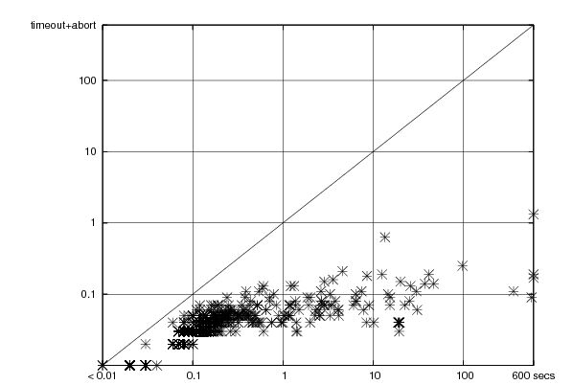
SMT - Milestones
year | Milestone
1977 | Efficient Equality Reasoning
1979 | Theory Combination Foundations
1979 | Arithmetic + Functions
1982 | Combining Canonizing Solvers
1992-8 | Systems: PVS, Simplify, STeP, SVC
2002 | Theory Clause Learning
2005 | SMT competition
2006 | Efficient SAT + Simplex
2007 | Efficient Equality Matching
2009 | Combinatory Array Logic, …
Z3
(of ’07)
Time
On
Boogie Regression
1sec
Simplify (of ’01) time
Z3
Time
On
VCC
Regression
Includes progress from SAT:
SAT
Theory
Solvers
SMT
15KLOC + 215KLOC = Z3
Nov 08
March 09

Slide 16
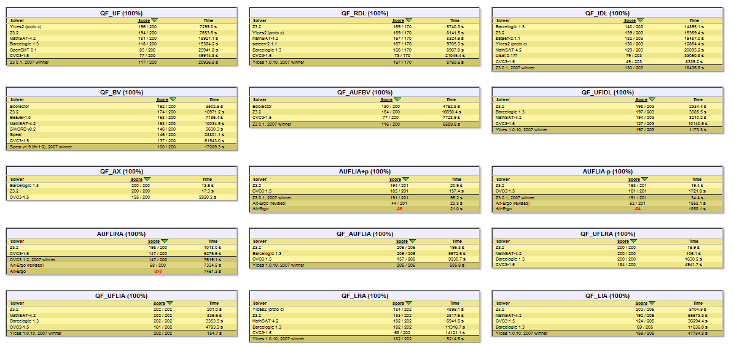
Z3 participates in and wins SMT competitions

Slide 17
RiSE - a primer
Symbolic Reasoning
Engines using Z3
What is SMT?
Little Engies of Proof
Solver: Interaction
Directions
Extra: Nuts and Bolts
Engines
Using
Z3

Slide 18

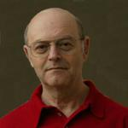
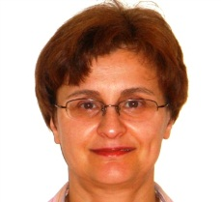


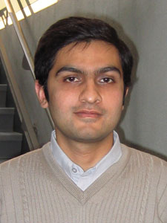

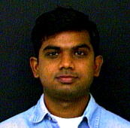

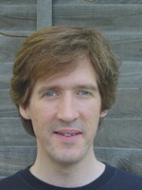




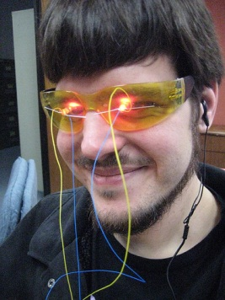


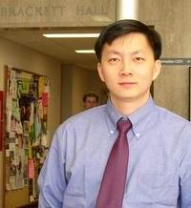

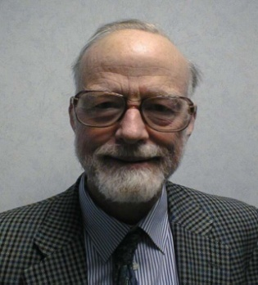
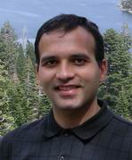
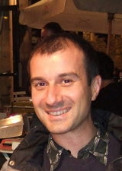
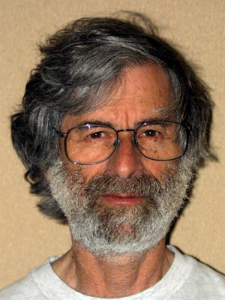



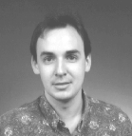
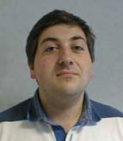
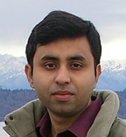





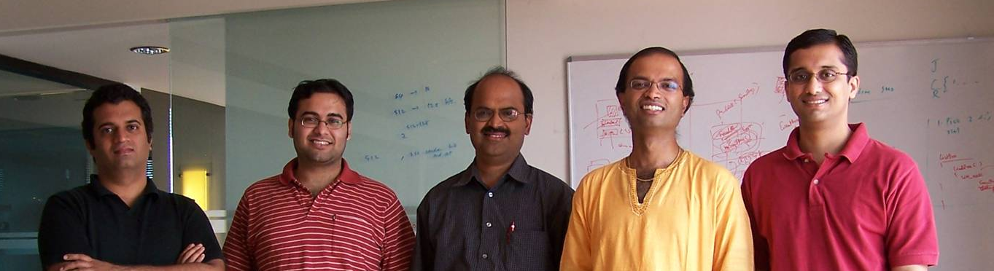


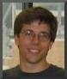


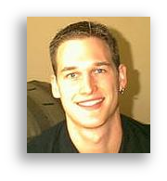
Microsoft Researchers using Symbolic Logic Engines

Slide 19
Domains from programs
Bits and bytes
Numbers
Arrays
Records
Heaps
Data-types
Object inheritance

Slide 20
Applications
Test case Generation
Verifying Compilers
Model Checking
Invariant Generation
Type Checking
Model Based Testing

Slide 21
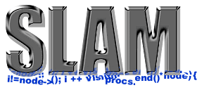




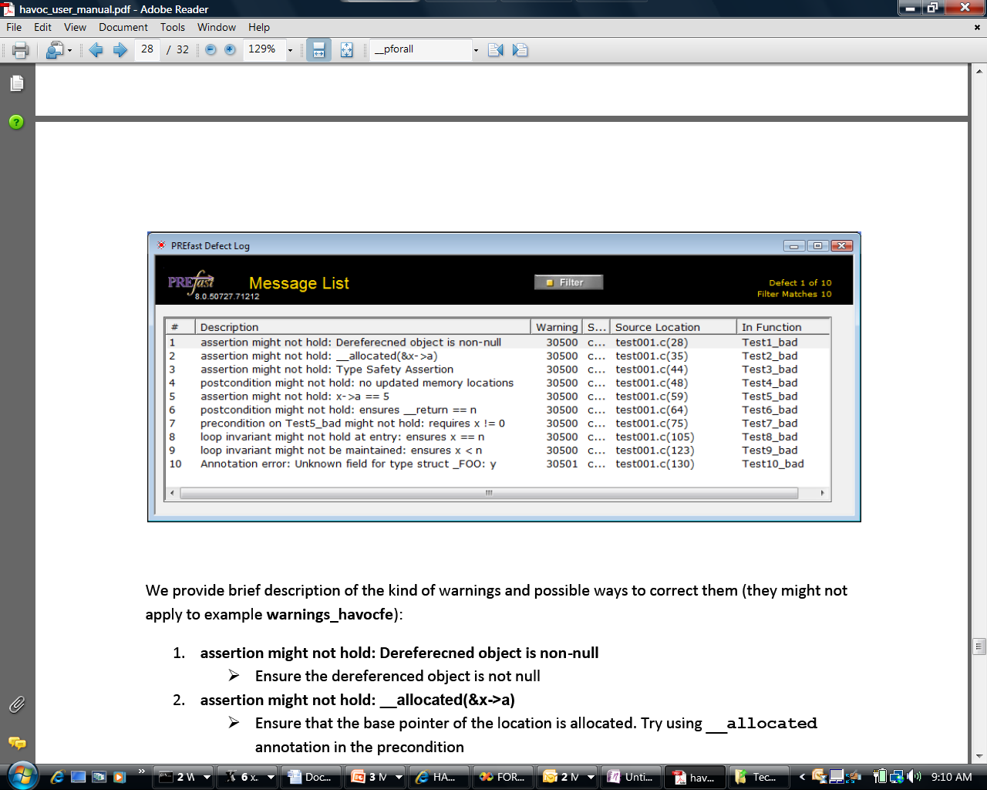
Some Microsoft Engines using Z3
SDV: The Static Driver Verifier
Pex: Program EXploration for .NET
SAGE: Scalable Automated Guided Execution
Spec#: C# + contracts
VCC: Verifying C Compiler for the Viridian Hyper-Visor
HAVOC: Heap-Aware Verification of C-code
SpecExplorer: Model-based testing of protocol specs
Yogi: Dynamic symbolic execution + abstraction
FORMULA: Model-based Design
PREfix: The Static Analysis Engine for C/C++
F7: Refinement types for security protocols
Rex: Regular Expressions and formal languages
VS3: Abstract interpretation and Synthesis
VERVE: Verified operating system
FINE: Proof carrying certified code
SLAyer: Separation Logic-based Static Analysis

Slide 22
Test case generation
unsigned GCD(x, y) {
requires(y > 0);
while (true) {
unsigned m = x % y;
if (m == 0) return y;
x = y;
y = m;
}
}
(y₀ > 0) and
(m₀ = x₀ % y₀) and
not (m₀ = 0) and
(x₁ = y₀) and
(y₁ = m₀) and
(m₁ = x₁ % y₁) and
(m₁ = 0)
x₀ = 2
y₀ = 4
m₀ = 2
x₁ = 4
y₁ = 2
m₁ = 0
SSA
Solver
We want a trace where the loop is executed twice.

Slide 23
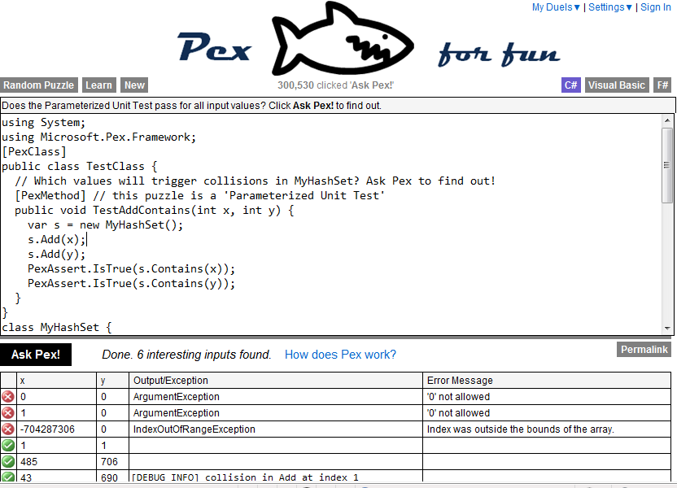
Pex – Program Exploration

Slide 24
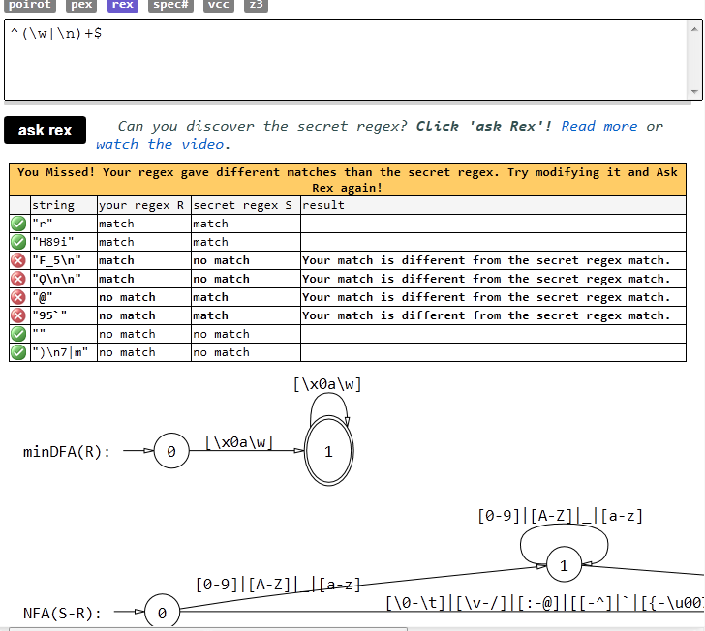
Rex – Regular Expression Exploration

Slide 25
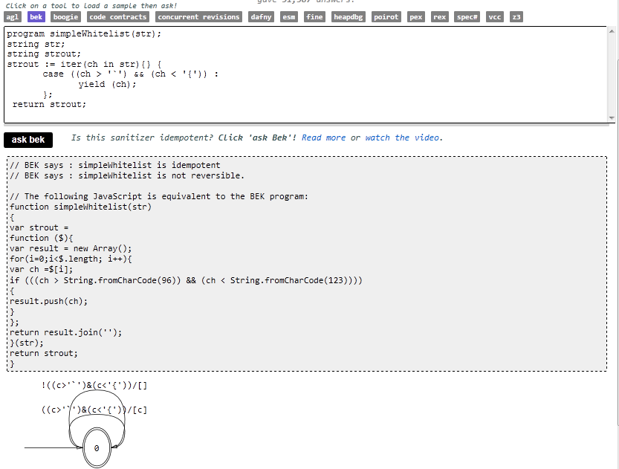
Bek – Symbolic Transducers

Slide 26
FINE: F# with Refinement Types
Signature:
div : int, { x : int | x ≠ 0 } → int
Subtype
Call site:
if a ≤ 1 and a ≤ b then
return div(a, b)
Verification condition
a ≤ 1 and a ≤ b implies b ≠ 0

Slide 27
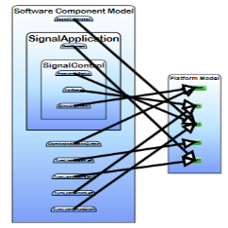
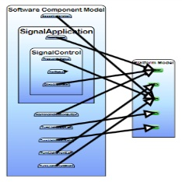
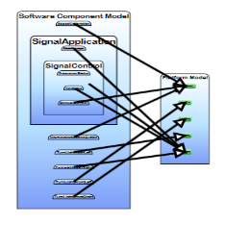
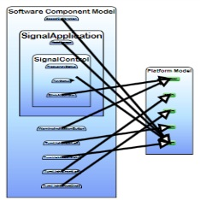
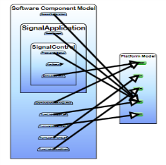
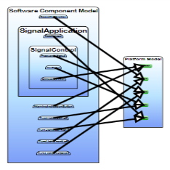
FORMULA: Design Space Exploration
Use Design Space Exploration to identify valid candidate architectures

Slide 28


Extended Static Checking and Verification
Hyper-V
VCC
Boogie
NTFS, SymDiff
HAVOC
Verification
condition
Bug path
F7/FINE

Slide 29
RiSE - a primer
Symbolic Reasoning
Engines using Z3
What is SMT?
Little Engines of Proof
Solver: Interaction
Solver: Nuts and Bolts
Directions
What is
SMT?

Slide 30
Satisfiability Modulo Theories (SMT)
b + 2 = c and f(read(write(a,b,3), c-2)) ≠ f(c-b+1)

Slide 31
Satisfiability Modulo Theories (SMT)
b + 2 = c and f(read(write(a,b,3), c-2)) ≠ f(c-b+1)
Arithmetic

Slide 32
Satisfiability Modulo Theories (SMT)
b + 2 = c and f(read(write(a,b,3), c-2)) ≠ f(c-b+1)
Array Theory
Arithmetic

Slide 33
Satisfiability Modulo Theories (SMT)
b + 2 = c and f(read(write(a,b,3), c-2)) ≠ f(c-b+1)
Uninterpreted Functions
Array Theory
Arithmetic

Slide 34
Satisfiability Modulo Theories (SMT)
b + 2 = c and f(read(write(a,b,3), c-2)) ≠ f(c-b+1)
Substituting c by b+2

Slide 35
Satisfiability Modulo Theories (SMT)
b + 2 = c and f(read(write(a,b,3), b+2-2)) ≠ f(b+2-b+1)
Simplifying

Slide 36
Satisfiability Modulo Theories (SMT)
b + 2 = c and f(read(write(a,b,3), b)) ≠ f(3)

Slide 37
Satisfiability Modulo Theories (SMT)
b + 2 = c and f(read(write(a,b,3), b)) ≠ f(3)
Applying array theory axiom
forall a,i,v: read(write(a,i,v), i) = v

Slide 38
Satisfiability Modulo Theories (SMT)
b + 2 = c and f(3) ≠ f(3)
Inconsistent/Unsatisfiable

Slide 39

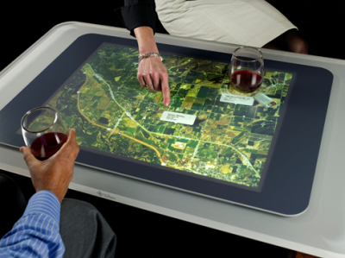




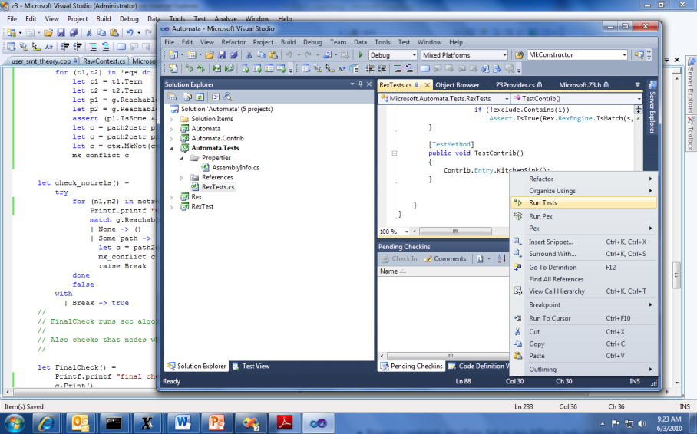


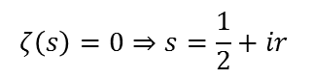
SMT by Example: Job Shop Scheduling
Machines
Tasks
Jobs
P = NP?
Laundry
$$ζ\left(s\right)=0⇒s=\frac{1}{2}+ir$$

Slide 40
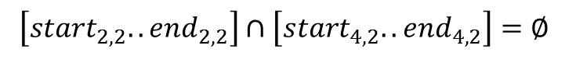
Job Shop Scheduling
Constraints:
Precedence: between two tasks of the same job
Resource: Machines execute at most one job at a time
3
1
2
4
$$\left[start_{2,2}..end_{2,2}\right]∩\left[start_{4,2}..end_{4,2}\right]=∅$$

Slide 41
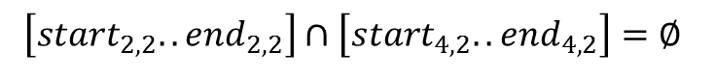
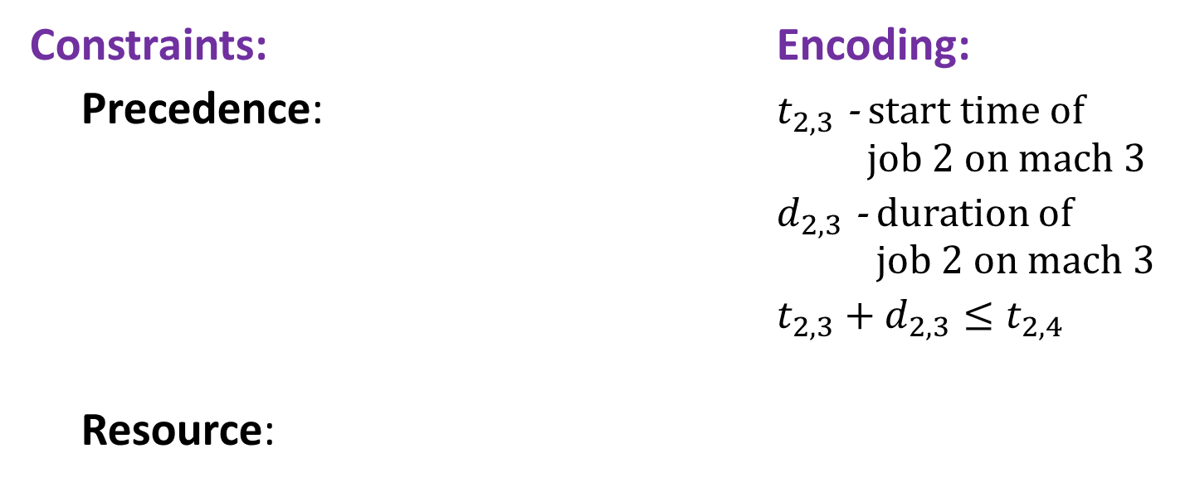
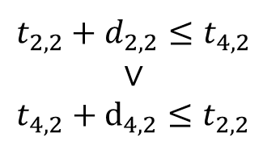
Job Shop Scheduling
Constraints: Encoding:
Precedence: $t_{2,3}$ - start time of job 2 on mach 3
$d_{2,3}$ - duration of job 2 on mach 3
$t_{2,3}+d_{2,3}≤t_{2,4}$
Resource:
3
1
4
2
Not convex
$$t_{2,2}+d_{2,2}≤t_{4,2}$$
$$∨$$
$$t_{4,2}+d_{4,2}≤t_{2,2}$$
$$\left[start_{2,2}..end_{2,2}\right]∩\left[start_{4,2}..end_{4,2}\right]=∅$$

Slide 42
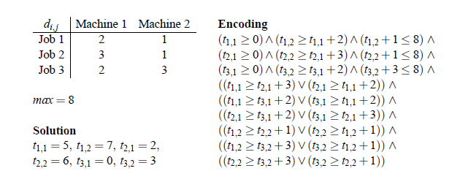
Job Shop Scheduling

Slide 43
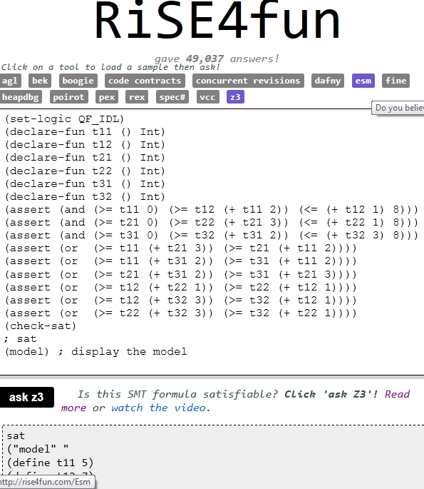
From Constraints To Models

Slide 44
RiSE - a primer
Symbolic Reasoning
Engines using Z3
What is SMT?
Little Engines of Proof
Solver: Interaction
Directions
Extra: Nuts and Bolts
Little
Engines
of Proof

Slide 45
Little Engines of Proof
An SMT Solver is a collection of
Little Engines of Proof

Slide 46
Little Engines of Proof
An SMT Solver is a collection of
Little Engines of Proof
Examples:
SAT Solver
Equality solver
Arithmetic solver

Slide 47

SMT : Basic Architecture
SAT
Theory
Solvers
SMT
Equality + UF
Arithmetic
Bit-vectors
Data-types
…
Case Analysis
15KLOC + 215KLOC = Z3

Slide 48
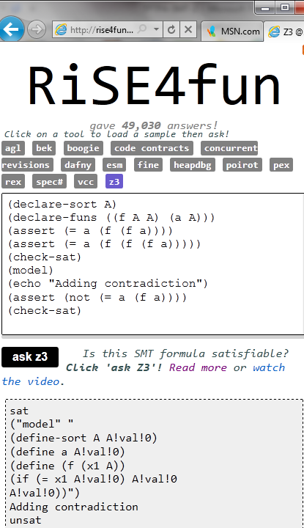
Theories
Uninterpreted functions
Arithmetic (linear)
Bit-vectors
Algebraic data-types
Arrays
User-defined

Slide 49
Theories
Uninterpreted functions
Arithmetic (linear)
Bit-vectors
Algebraic data-types
Arrays
User-defined

Slide 50
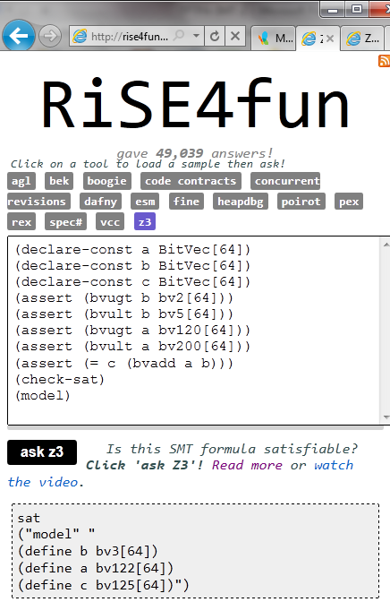
Theories
Uninterpreted functions
Arithmetic (linear)
Bit-vectors
Algebraic data-types
Arrays
User-defined

Slide 51
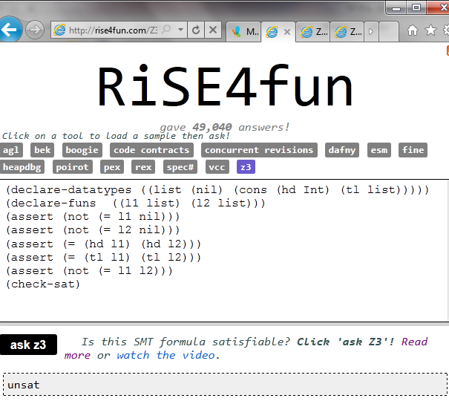
Theories
Uninterpreted functions
Arithmetic (linear)
Bit-vectors
Algebraic data-types
Arrays
User-defined

Slide 52
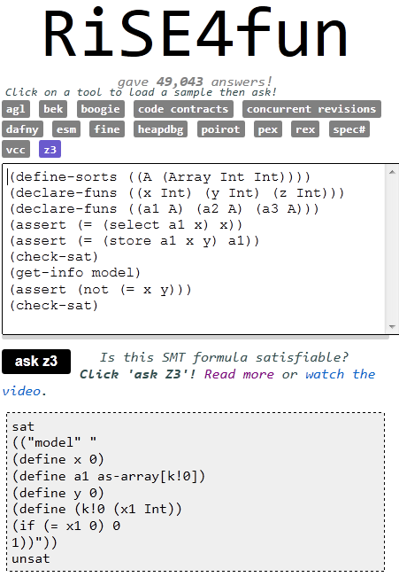
Theories
Uninterpreted functions
Arithmetic (linear)
Bit-vectors
Algebraic data-types
Arrays
User-defined

Slide 53
RiSE - a primer
Symbolic Reasoning
Engines using Z3
What is SMT?
Little Engines of Proof
Solver: Interaction
Directions
Extra: Nuts and Bolts
Solver:
Interaction

Slide 54
Interaction
Text:
SMT-LIB1.2
SMT-LIB2
Native Z3 (low-level)
Simplify
Programmatic APIs:
C
.NET, F#, LINQ
Ocaml
Python, ..
Example: Quotations in F#
open Microsoft.Z3
open Microsoft.Z3.Quotations
do Solver.prove <@ Logic.declare
(fun t11 t12 t21 t22 t31 t32 ->
not
((t11 >= 0I) && (t12 >= t11 + 2I) && (t12 + 1I <= 8I) &&
(t21 >= 0I) && (t22 >= t21 + 3I) && (t32 + 1I <= 8I) &&
(t31 >= 0I) && (t32 >= t31 + 2I) && (t32 + 3I <= 8I) &&
(t11 >= t21 + 3I || t21 >= t11 + 2I) &&
(t11 >= t31 + 2I || t31 >= t11 + 2I) &&
(t21 >= t31 + 2I || t31 >= t21 + 3I) &&
(t12 >= t22 + 1I || t22 >= t12 + 1I) &&
(t12 >= t32 + 3I || t32 >= t12 + 1I) &&
(t22 >= t32 + 3I || t32 >= t22 + 1I)
)
)
@>

Slide 55
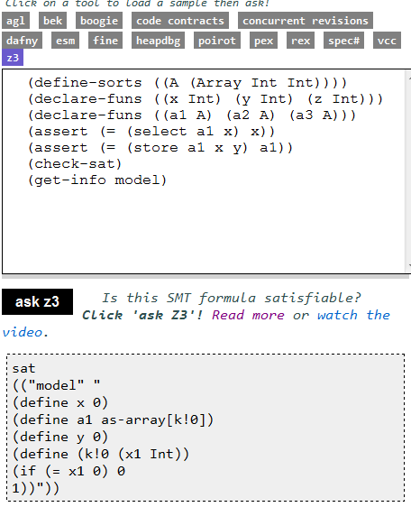
Interaction - models
Logical Formula
Sat/Model

Slide 56
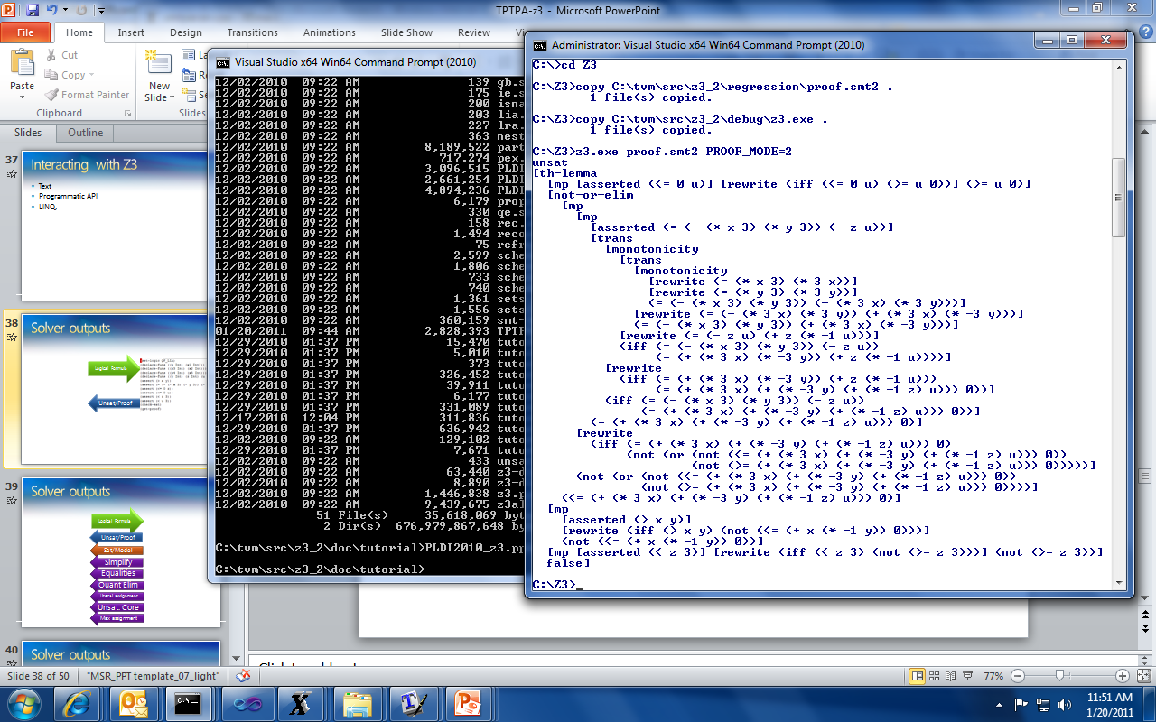
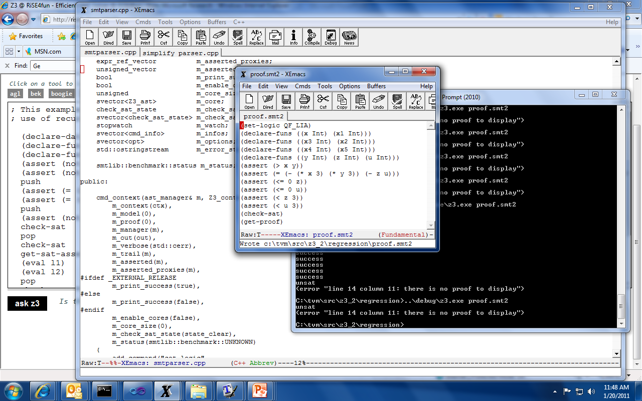
Interaction – proof objects
Logical Formula
Unsat/Proof

Slide 57

Interaction - simplification
Logical Formula
Simplify

Slide 58

Interaction - equalities
Logical Formula
x and y are equal
z + y and x + z are equal
Implied
Equalities

Slide 59

Interaction – quantifier elimination
Logical Formula
Quantifier
Elimination

Slide 60

Interaction – unsat cores
Logical Formula
Unsat. Core

Slide 61
RiSE - a primer
Symbolic Reasoning
Engines using Z3
What is SMT?
Little Engines of Proof
Solver: Interaction
Directions
Extra: Nuts and Bolts
Directions

Slide 62
Research around Z3
Decision Procedures
Modular Difference Logic is Hard TR 08 B, Blass Gurevich, Muthuvathi.
Linear Functional Fixed-points. CAV 09 B. & Hendrix.
A Priori Reductions to Zero for Strategy-Independent Gröbner Bases SYNASC 09 M& Passmore.
Efficient, Generalized Array Decision Procedures FMCAD 09 M & B
Combining Decision Procedures
Model-based Theory Combination SMT 07 M & B. .
Accelerating Lemma learning using DPLL(U) LPAR 08 B, Dutetre & M
Proofs, Refutations and Z3 IWIL 08 M & B
On Locally Minimal Nullstellensatz Proofs. SMT 09 M & Passmore.
A Concurrent Portfolio Approach to SMT Solving CAV 09 Wintersteiger, Hamadi & M
Quantifiers, quantifiers, quantifiers
Efficient E-matching for SMT Solvers. . CADE 07 M & B.
Relevancy Propagation. TR 07 M & B.
Deciding Effectively Propositional Logic using DPLL(Sx) IJCAR 08 M & B.
Engineering DPLL(T) + saturation. IJCAR 08 M & B.
Complete instantiation for quantified SMT formulas CAV 09 Ge & M.
On deciding satisfiability by DPLL( Γ+ T). CADE 09 Bonachina, M & Lynch.
Linear Quantifier Elimination as Abstract Decision Proc. IJCAR 10, B.
Efficiently Solving Quantified Bit-Vector Formulas FMCAD 10, Wintersteiger, Hamadi, M.
.
.
.

Slide 63


Current Efforts
Model-based Quantifier Elimination
Theories + Quantifiers from Models
μZ – An Efficient Engine For Fixed-points Datalog + Abstract Constraints
Points-to analysis, Knowledge bases, ..

Slide 64
Conclusions
SMT solvers are a great fit for software tools
Current main applications:
Test-case generation.
Verifying compilers.
Model Checking & Predicate Abstraction.
Model-based testing and development
New applications keep appearing:
Synthesis, Compiler optimization, Trace-based optimization,..

Slide 65
Extra:
Nuts and Bolts
RiSE - a primer
Symbolic Reasoning
Engines using Z3
What is SMT?
Little Engines of Proof
Solver: Interaction
Directions
Extra: Nuts and Bolts

Slide 66
Model-based Theory Combination
Foundations
Efficiency using rewriting
1979 Nelson, Oppen - Framework
1996 Tinelli & Harindi. N.O Fix
2000 Barrett et.al N.O + Rewriting
2002 Zarba & Manna. “Nice” Theories
2004 Ghilardi et.al. N.O. Generalized
1984 Shostak. Theory solvers
1996 Cyrluk et.al Shostak Fix #1
1998 B. Shostak with Constraints
2001 Rueß & Shankar Shostak Fix #2
2004 Ranise et.al. N.O + Superposition
2001: Moskewicz et.al. Efficient DPLL made guessing cheap
2006 Bruttomesso et.al. Delayed Theory Combination
2007 de Moura & B. Model-based Theory Combination
2010 Jovanovic & Barrett. Sharing is Caring

Slide 67
Combinatory Array Logic
A basis of operations
[FMCAD 2009]

Slide 68
Efficient E-graph Matching
Match: read(write(A,I,V),I) = read(write(a,g(c),c),f(d,a))
Assuming
E = { g(a) = f(b, c), b = d, a = c }
Efficiency through:
Code trees: Runtime program specialization.
Inverted path indexing: When new equality enters, walk from sub-terms upwards to roots in index.
[CADE 2007]

Slide 69
Efficient E-graph Matching
Match: read(write(A,I,V),I) = read(write(a,g(c),c),f(b,a))
Assuming
E = { g(a) = f(b, c), b = d, a = c }
Efficiency through:
Code trees: Runtime program specialization.
Inverted path indexing: When new equality enters, walk from sub-terms upwards to roots in index.
[CADE 2007]

Slide 70
Efficient E-graph Matching
Match: read(write(A,I,V),I) = read(write(a,g(c),c),f(b,c))
Assuming
E = { g(a) = f(b, c), b = d, a = c }
Efficiency through:
Code trees: Runtime program specialization.
Inverted path indexing: When new equality enters, walk from sub-terms upwards to roots in index.
[CADE 2007]

Slide 71
Efficient E-graph Matching
Match: read(write(A,I,V),I) = read(write(a,g(c),c),g(a))
Assuming
E = { g(a) = f(b, c), b = d, a = c }
Efficiency through:
Code trees: Runtime program specialization.
Inverted path indexing: When new equality enters, walk from sub-terms upwards to roots in index.
[CADE 2007]

Slide 72
Efficient E-graph Matching
Match: read(write(A,I,V),I) = read(write(a,g(c),c),g(c))
Assuming
E = { g(a) = f(b, c), b = d, a = c }
Efficiency through:
Code trees: Runtime program specialization.
Inverted path indexing: When new equality enters, walk from sub-terms upwards to roots in index.
[CADE 2007]

Slide 73
Linear quantifier Elimination as an Abstract Decision Procedure
SMT for QE has some appeal:
Just use SMT(LA/LIA) for closed formulas.
Algorithms:
Fourier Motzkin
Resolution
Omega
Test
Case split+
Virtual subst
Loos-Weisphening
Cooper
Case split+
Resolution
Abstract
Decision Proc
Abstract
Decision Proc
[IJCAR 2010]

Slide 74
DPLL
M | F
Partial model
Set of clauses

Slide 75
DPLL
Guessing
p | p ∨ q, ¬q ∨ r
p, ¬q | p ∨ q, ¬q ∨ r

Slide 76
DPLL
Deducing
p | p ∨ q, ¬p ∨ s
p, s| p ∨ q, ¬p ∨ s

Slide 77
DPLL
Backtracking
p, ¬s, q | p ∨ q, s ∨ q, ¬p∨ ¬q
p, s| p ∨ q, s ∨ q, ¬p∨ ¬q

Slide 78
Modern DPLL
Efficient indexing (two-watch literal)
Non-chronological backtracking (backjumping)
Lemma learning

Slide 79
SAT + Theory solvers
Basic Idea
x ≥ 0, y = x + 1, (y > 2 ∨ y < 1)
Abstract (aka “naming” atoms)
p₁, p₂, (p₃ ∨ p₄)
p₁ ≡ (x ≥ 0), p₂ ≡ (y = x + 1),
p₃ ≡ (y > 2), p₄ ≡ (y < 1)

Slide 80
SAT + Theory solvers
Basic Idea
x ≥ 0, y = x + 1, (y > 2 ∨ y < 1)
Abstract (aka “naming” atoms)
p₁, p₂, (p₃ ∨ p₄)
p₁ ≡ (x ≥ 0), p₂ ≡ (y = x + 1),
p₃ ≡ (y > 2), p₄ ≡ (y < 1)
SAT
Solver

Slide 81
SAT + Theory solvers
Basic Idea
x ≥ 0, y = x + 1, (y > 2 ∨ y < 1)
Abstract (aka “naming” atoms)
p₁, p₂, (p₃ ∨ p₄)
p₁ ≡ (x ≥ 0), p₂ ≡ (y = x + 1),
p₃ ≡ (y > 2), p₄ ≡ (y < 1)
SAT
Solver
Assignment
p₁, p₂, ¬p₃, p₄

Slide 82
SAT + Theory solvers
Basic Idea
x ≥ 0, y = x + 1, (y > 2 ∨ y < 1)
Abstract (aka “naming” atoms)
p₁, p₂, (p₃ ∨ p₄)
p₁ ≡ (x ≥ 0), p₂ ≡ (y = x + 1),
p₃ ≡ (y > 2), p₄ ≡ (y < 1)
SAT
Solver
Assignment
p₁, p₂, ¬p₃, p₄
x ≥ 0, y = x + 1,
¬(y > 2), y < 1

Slide 83
SAT + Theory solvers
Basic Idea
x ≥ 0, y = x + 1, (y > 2 ∨ y < 1)
Abstract (aka “naming” atoms)
p₁, p₂, (p₃ ∨ p₄)
p₁ ≡ (x ≥ 0), p₂ ≡ (y = x + 1),
p₃ ≡ (y > 2), p₄ ≡ (y < 1)
SAT
Solver
Assignment
p₁, p₂, ¬p₃, p₄
x ≥ 0, y = x + 1,
¬(y > 2), y < 1
Unsatisfiable
x ≥ 0, y = x + 1, y < 1
Theory
Solver

Slide 84
SAT + Theory solvers
Basic Idea
x ≥ 0, y = x + 1, (y > 2 ∨ y < 1)
Abstract (aka “naming” atoms)
p₁, p₂, (p₃ ∨ p₄)
p₁ ≡ (x ≥ 0), p₂ ≡ (y = x + 1),
p₃ ≡ (y > 2), p₄ ≡ (y < 1)
SAT
Solver
Assignment
p₁, p₂, ¬p₃, p₄
x ≥ 0, y = x + 1,
¬(y > 2), y < 1
New Lemma
¬p₁∨¬p₂∨¬p₄
Unsatisfiable
x ≥ 0, y = x + 1, y < 1
Theory
Solver

Slide 85
SAT + Theory solvers
New Lemma
¬p₁∨¬p₂∨¬p₄
Unsatisfiable
x ≥ 0, y = x + 1, y < 1
Theory
Solver
AKA
Theory conflict

Slide 86
SAT + Theory solvers: Main loop
procedure SmtSolver(F)
(F_{p}, M) := Abstract(F)
loop
(R, A) := SAT_solver(F_{p})
if R = UNSAT then return UNSAT
S := Concretize(A, M)
(R, S’) := Theory_solver(S)
if R = SAT then return SAT
L := New_Lemma(S’, M)
Add L to F_{p}

Slide 87
SAT + Theory solvers
Basic Idea
F: x ≥ 0, y = x + 1, (y > 2 ∨ y < 1)
Abstract (aka “naming” atoms)
F_{p} : p₁, p₂, (p₃ ∨ p₄)
M: p₁ ≡ (x ≥ 0), p₂ ≡ (y = x + 1),
p₃ ≡ (y > 2), p₄ ≡ (y < 1)
SAT
Solver
A: Assignment
p₁, p₂, ¬p₃, p₄
S: x ≥ 0, y = x + 1,
¬(y > 2), y < 1
L: New Lemma
¬p₁∨¬p₂∨¬p₄
S’: Unsatisfiable
x ≥ 0, y = x + 1, y < 1
Theory
Solver

Slide 88
SAT + Theory solvers
F: x ≥ 0, y = x + 1, (y > 2 ∨ y < 1)
Abstract (aka “naming” atoms)
F_{p} : p₁, p₂, (p₃ ∨ p₄)
M: p₁ ≡ (x ≥ 0), p₂ ≡ (y = x + 1),
p₃ ≡ (y > 2), p₄ ≡ (y < 1)
SAT
Solver
A: Assignment
p₁, p₂, ¬p₃, p₄
S: x ≥ 0, y = x + 1,
¬(y > 2), y < 1
L: New Lemma
¬p₁∨¬p₂∨¬p₄
S’: Unsatisfiable
x ≥ 0, y = x + 1, y < 1
Theory
Solver
procedure SMT_Solver(F)
(F_{p}, M) := Abstract(F)
loop
(R, A) := SAT_solver(F_{p})
if R = UNSAT then return UNSAT
S = Concretize(A, M)
(R, S’) := Theory_solver(S)
if R = SAT then return SAT
L := New_Lemma(S, M)
Add L to F_{p}
“Lazy translation” to
DNF

Slide 89
SAT + Theory solvers
State-of-the-art SMT solvers implement
many improvements.

Slide 90
SAT + Theory solvers
Incrementality
Send the literals to the Theory solver as they are assigned by the SAT solver
p₁ ≡ (x ≥ 0), p₂ ≡ (y = x + 1),
p₃ ≡ (y > 2), p₄ ≡ (y < 1), p₅ ≡ (x < 2),
p₁, p₂, p₄ | p₁, p₂, (p₃ ∨ p₄), (p₅ ∨ ¬p₄)
Partial assignment is already
Theory inconsistent.

Slide 91
SAT + Theory solvers
Efficient Backtracking
We don’t want to restart from scratch after each backtracking operation.

Slide 92
SAT + Theory solvers
Efficient Lemma Generation (computing a small S’)
Avoid lemmas containing redundant literals.
p₁ ≡ (x ≥ 0), p₂ ≡ (y = x + 1),
p₃ ≡ (y > 2), p₄ ≡ (y < 1), p₅ ≡ (x < 2),
p₁, p₂, p₃, p₄ | p₁, p₂, (p₃ ∨ p₄), (p₅ ∨ ¬p₄)
¬p₁∨¬p₂ ∨¬p₃ ∨¬p₄
Imprecise Lemma

Slide 93
SAT + Theory solvers
Theory Propagation
It is the SMT equivalent of unit propagation.
p₁ ≡ (x ≥ 0), p₂ ≡ (y = x + 1),
p₃ ≡ (y > 2), p₄ ≡ (y < 1), p₅ ≡ (x < 2),
p₁, p₂ | p₁, p₂, (p₃ ∨ p₄), (p₅ ∨ ¬p₄)
p₁, p₂ imply ¬p₄ by theory propagation
p₁, p₂ , ¬p₄ | p₁, p₂, (p₃ ∨ p₄), (p₅ ∨ ¬p₄)

Slide 94
SAT + Theory solvers
Theory Propagation
It is the SMT equivalent of unit propagation.
p₁ ≡ (x ≥ 0), p₂ ≡ (y = x + 1),
p₃ ≡ (y > 2), p₄ ≡ (y < 1), p₅ ≡ (x < 2),
p₁, p₂ | p₁, p₂, (p₃ ∨ p₄), (p₅ ∨ ¬p₄)
p₁, p₂ imply ¬p₄ by theory propagation
p₁, p₂ , ¬p₄ | p₁, p₂, (p₃ ∨ p₄), (p₅ ∨ ¬p₄)
Tradeoff between precision × performance.

Slide 95
An Architecture: the core
Core
Arithmetic
Bit-Vectors
Scalar Values
Equality
Uninterpreted Functions
SAT Solver

Slide 96
An Architecture: the core
Core
Arithmetic
Bit-Vectors
Scalar Values
Equality
Uninterpreted Functions
Case Analysis
SAT Solver

Slide 97
An Architecture: the core
Core
Arithmetic
Bit-Vectors
Scalar Values
Equality
Uninterpreted Functions
Blackboard:
equalities, disequalities,
predicates
SAT Solver

